Slide 1
Welcome
#18: Engaging And Empowering Front Line Managers
Jerome Chapman, CSP
Corporate Safety Manager, ITU ABSORBTECH, INC.
Notes:
It would be nice if all managers were safety managers.
Like this room everyone would be pumped about safety .
Reality is most managers don’t know where to begin to manage safety let alone to how to have safety culture they can be proud or. They’ll tell you I can’t walk on water.
So today we are going to talk about how to give your front line managers the confidence to walk on water or at least how to swim/float and the confidence to ensure their employees return home safely every day.

Slide 2
Agenda
Let’s Talk About Time Management
Needs analysis to achieve safety metrics
Proactive actions/activities
Tools to guide managers
Tracking for accountability of actions/activities to safety metrics
Communication of success of individual and company safety metrics
Notes:
The first thing is a needs analysis.
managers will tell you their need. You want me to do all this safety stuff I need more money.
we will look at setting proactive action and activities based on the needs analysis.
We will look at what types of tools will guide the managers to lead/manage/ create a safety culture they will be proud of. Including how to hold their team and themselves accountable.
What you need to do to communicate success by individual managers and how that related to the company safety metrics.
I will show you the money more often never ever yearn

Slide 3
A manager’s Safety performance is about time spent.
As a manager they will spend time on safety
They have a choice
Time will be spent on reactive (directly after and incident)
Incident report/Root cause analysis and corrective actions
OSHA violations
Lost productivity
Notification of family members
Time spent on proactive preventative actions are scheduled by the manager
Coaching (employee observations, communicating expectations, safety training)
Area safety Audits i.e. housekeeping, hazard identification

Slide 4
Needs Analysis
Where to start
General risk to industry
Needs analysis specific to your organization
Identify risks in each manager’s area of responsibility

Slide 5
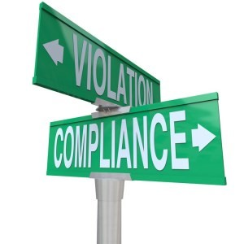
General risk to industry
Fall Protection – General Requirements (1926.501): 5,295 violations
Respiratory Protection (1910.134): 2,527
Ladders (1926.1053): 2,026
Scaffolding (1926.451): 1,948
Hazard Communication (1910.1200): 1,947
Lockout/Tagout (1910.147): 1,698
Fall Protection – Training Requirements (1926.503): 1,666
Personal Protective and Lifesaving Equipment – Eye and Face Protection (1926.102): 1,452
Powered Industrial Trucks (1910.178): 1,420
Machine Guarding (1910.212): 1,113
“The Top 10 most frequently cited workplace safety standards for FY 2021” www.nsc.com

Slide 6
Needs analysis specific to your organization
Support from upper management
Human Resources. Enforcement of safety rules and company expectations
Top management setting company safety metrics
Front line managers will focus on what top managers require
Where are your incidents happening.
Where is your risk (frequency and severity)

Slide 7
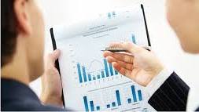
Needs analysis specific to your organization
Identify typical risk per area/per manager
Office managers evaluation of housekeeping and ergonomics
Space heaters used by paper recycling bin
Office chairs in bad condition
File drawers left open
Plant/operation manager
Power industrial trucks entering blind intersections at high rate of speed
Compressed gas cylinders without designated storage area
Manual lifting of 75 lbs. boxes repeatedly
Fleet manager
Load securement inadequate
Unreported truck damage
Work instructions/Standard Operating Procedure missing safety applies to each area/manager.

Slide 8
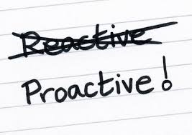
Identify Proactive Actions and Activities
Review work instructions/standard operating practices for missing safety instructions
Watch, look, inspect
To ensure Power industrial truck rules are being followed
To ensure truck loads are secured
Equipment is in a safe condition(chairs repaired/replaced)
Housekeeping list
Identify location for proper compressed gas cylinders
Check file drawers are pushed in
Space heaters are not used/near paper recycling
Identify opportunities for improvement
Develop fleet accountability
Assign vehicles
Verify safety training (pre & post trip inspection, proper reporting)
Method to reduce manual lifting
Improve training and Content
Notes:
These proactive actions are the most likely drive change/ reduce risk and help systematically achieve safety metrics

Slide 9
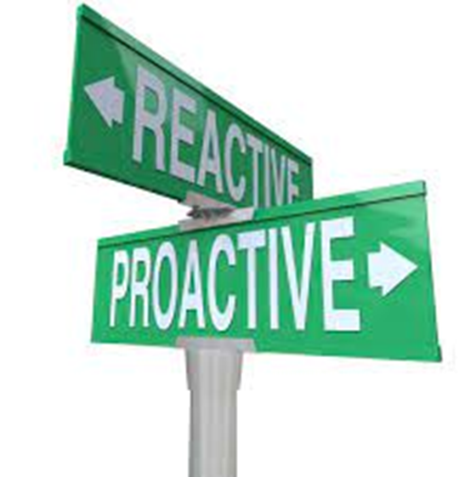
Confidence
Managers want to succeed
Next step is to help guide them
Time spent on safety is their choice
Share how reactive incident time is on demand disrupting the daily routine
Same time spent on proactive will result in managers having control
Share how the proactive steps were determined and how the individual manager’s action will reduce their team’s risk of incidents
Managers need the reason for the proactive activities and the tools to perform those activities well

Slide 10
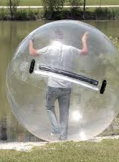
Tools to Guide Managers
Tools can include training on proper procedures to proper use of equipment Task is to safely walk on water!
A demonstration on how
to walk like a penguin.
Use of the bubble could include
confined space training and air monitoring

Slide 11
Tools to guide managers
Provide a guide - specific to each managers on activities to perform and how often
Keep the tools simple
Examples of tools:
Checkist
Audit forms
Task observation forms
Utilize online training/data reporting
Use technology

Slide 12
Provide guidance in the tool for corrective action and coaching
The SMART method helps you effectively approach reaching your goals in the workplace. The SMART acronym stands for:
Specific: making sure they’re well-defined. Determine the who, what, where, when and why
Measurable: Develop the key indicators that help you decide if & when you reach your goal by quantifying them
Achievable: Create achievable goals by ensuring that you and your team have the skills and resources
Relevant: Align your company goals with the overall objectives of your business and the realities of the market
Time-bound: Create a deadline to provide a sense of urgency and opportunity to schedule the steps to take to achieve the goals

Slide 13
Provide guidance in the tool for corrective action and coaching
Outline expectation and corrective action
Let them know they are on track or what will happen if they do not correct habit within a month.
Review any deficiency and the corrective action with employee.
As soon as practical after observation is complete
Repeat observation of employee for corrective action results
Minimum of weekly
Review corrective actions progress and provide coaching
First few weeks to correct bad habits

Slide 14
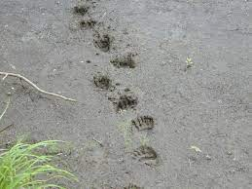
Tracking for accountability of actions/activities to safety metrics
Scorecards
Manager specific
List to guide them to perform specific activities designed to reduce risk of incidents.
Use electronic/paper or methods to document with least amount of effort
Connect actions/activities to safety metrics and to performance reviews

Slide 15
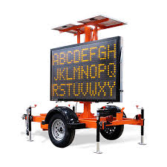
Communicating the success of individual and company safety metrics
As managers realize success…
Others will be more willing to participate
Company safety metrics will improve
Celebrate the success!
The Individual, Manager and Company
Review performance and adjust safety metrics routinely
Celebrate!
Communicate!

Slide 16
Let’s Talk About Implementation and Examples
Scorecards
Daily Pre-Trip Inspection
Power Industrial Truck Observation
Employee General Knowledge and Work Instructions
Proper Lifting Methods (Demonstrate)
PPE, Housekeeping and Working Defensively
Powered Devices and Non-Powered Devices
Improvement Plan/Timeline/Corrective Actions

Slide 17
Scorecards
WHAT IS THIS…
tracking system
WHAT IS THIS USED FOR….
set proactive safety activities for individual managers that drive risk control and help achieve safety metrics

Slide 18
Daily Pre-Trip Inspection
Used to ensure pre-trip truck inspections are completed daily and to hold drivers responsible for damages.
Helps to ensure proper reporting!

Slide 19
Power Industrial Truck Observation
Used as an observation form to ensure safe operation of Powered Industrial Trucks.

Slide 20
Employee General Knowledge and
Work Instructions
Observation used for general employee observation and assessment of knowledge to work safely while performing their job tasks

Slide 21
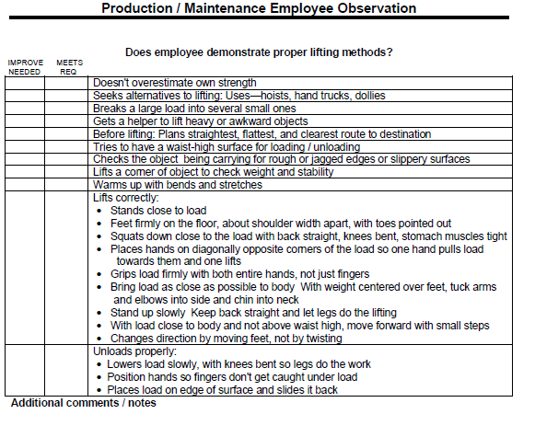
Proper Lifting Methods (Demonstrate)
Observation used to ensure proper lifting methods are used while performing job tasks

Slide 22
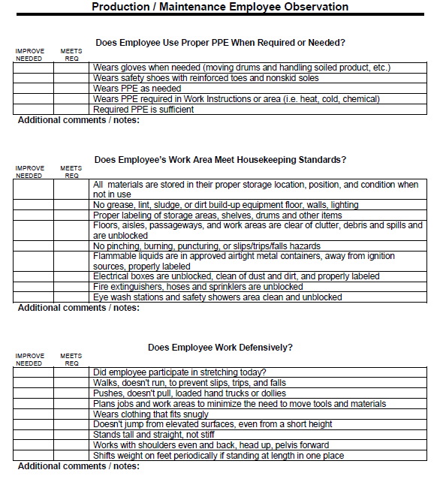
PPE, Housekeeping and Working Defensively
Observation used to ensure:
Proper PPE is used properly and when required
Housekeeping standards are up to expectations
Defensive safety habits are in place and used by the employee

Slide 23
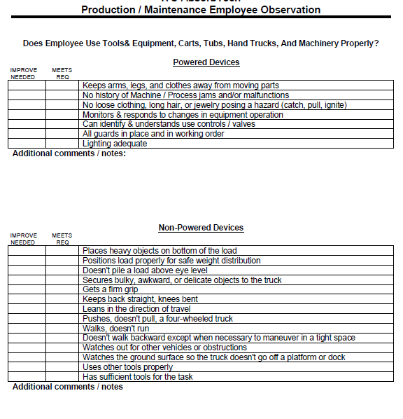
Powered Devices and Non-Powered Devices
Observation used to ensure powered devices and non-powered devices are used properly and safely

Slide 24
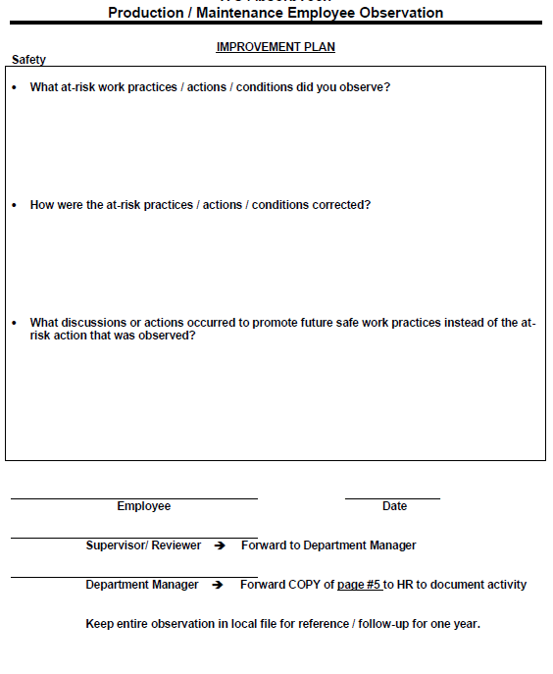
Improvement Plan/Timeline/Corrective Actions
Part of observation that:
Provides guidance on coaching employees
Defines corrective actions
Sets up timelines/SMART goal protocol

Slide 25
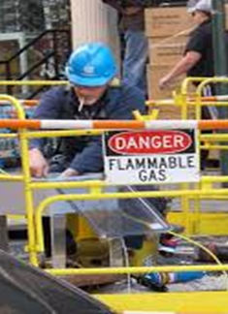
Recap
Let’s Talk About Time Management
Needs analysis to achieve safety metrics
Proactive actions/activities
Tools to guide managers
Tracking for accountability of actions/activities to safety metrics
Communication of success of individual and company safety metrics
Notes:
The first thing is a needs analysis.
managers will tell you their need. You want me to do all this safety stuff I need more money.
we will look at setting proactive action and activities based on the needs analysis.
We will look at what types of tools will guide the managers to lead/manage/ create a safety culture they will be proud of. Including how to hold their team and themselves accountable.
What you need to do to communicate success by individual managers and how that related to the company safety metrics.
I will show you the money more often never ever yearn

Slide 26
The way to get started is to quit talking and begin doing.
Walt Disney

Slide 27
Thank You
Jerome Chapman, CSP
Corporate Safety Manager, ITU ABSORBTECH, INC.

